Slide 1
Sunny Side of the Moon Website
Ali Nehme, Dmitry Kizyakov, Edgar Townsend, Matthew Rao, Mitchell Fridman, Rami Chaouki

Slide 2
Presentation Overview
Project
Workflow
Site Map

Slide 3

Project
Purpose
Target audience

Slide 4
Workflow
Brainstorm – Sitemap + Page Layout
MVP and WOW factors
Projected vs. Actual Work Pipeline
Role divisions
Git and Github

Slide 5
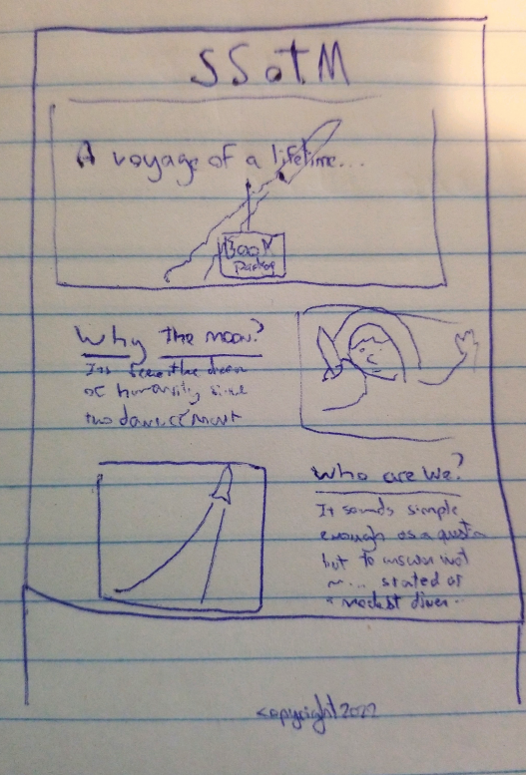
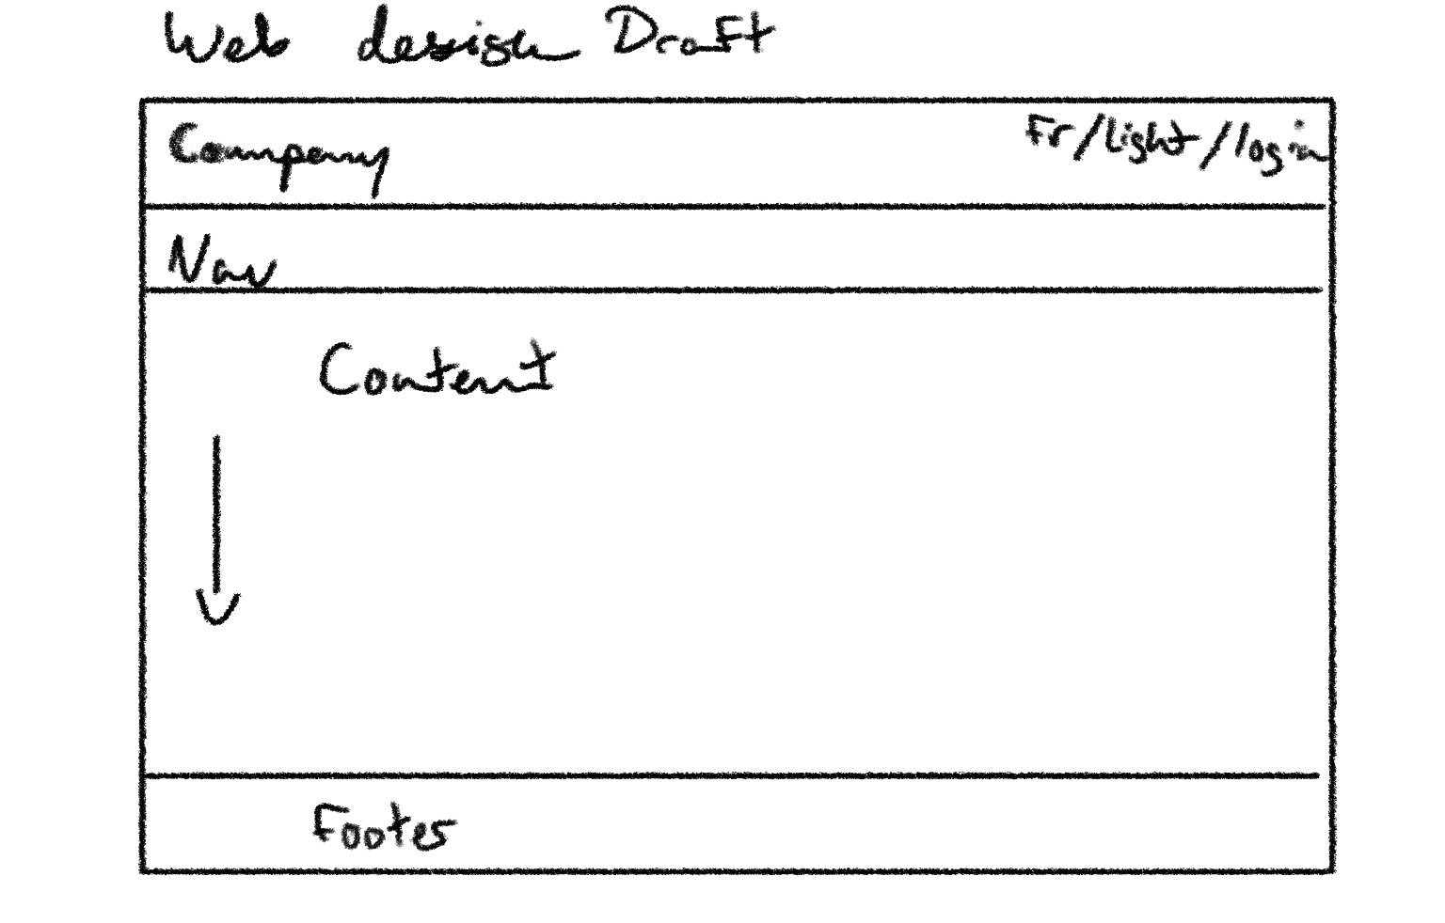
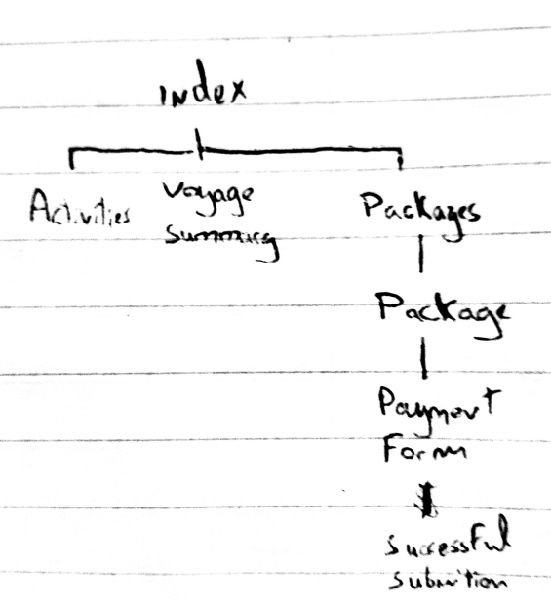
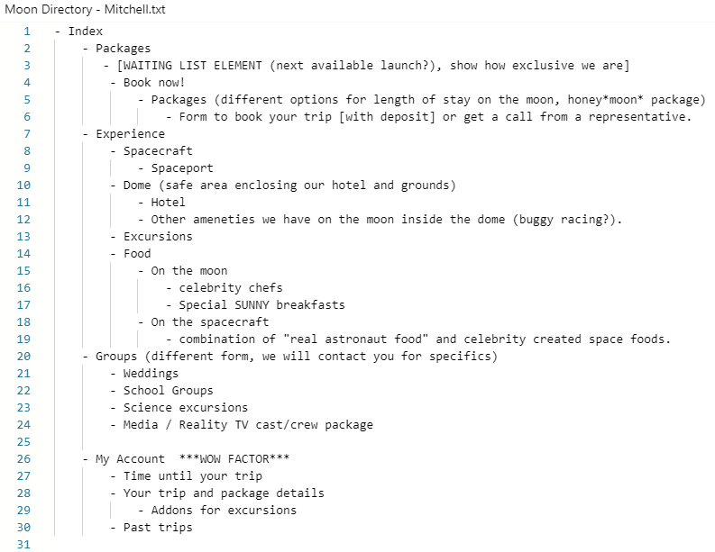
Brainstorm
Research: Sitemap + Page Layout

Slide 6
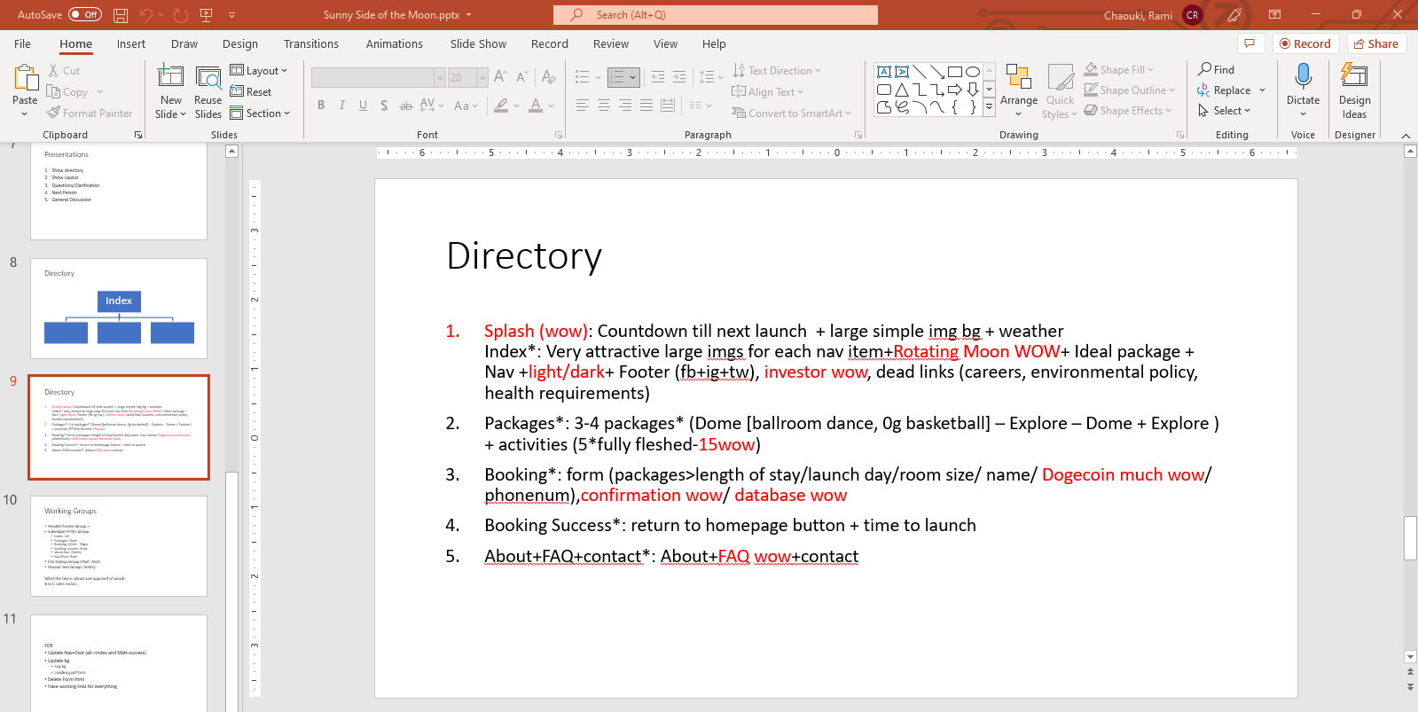
MVP and WOW factors
Why this division?

Slide 7
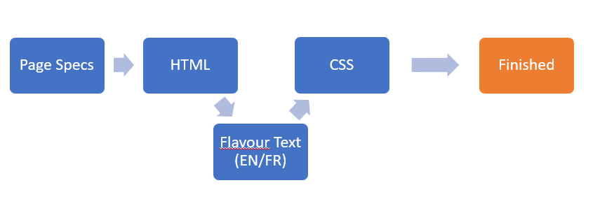
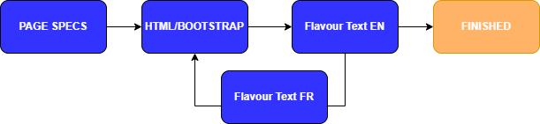
Initial Role Divisions
Team Lead: Rami
Header/Footer Group: Rami
Individual HTML Group:
Index : Ali
Packages: Rami
Booking: Mitch - Edgar
booking success: Matt
about faq : Dmitry
CSS Styling Group Chief: Matt
Flavour Text Group: Dmitry

Slide 8
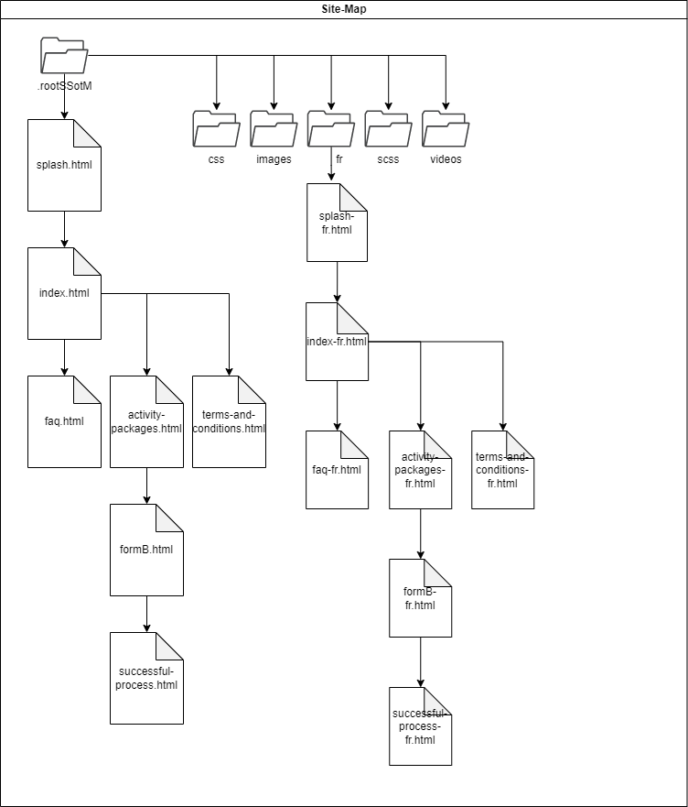
Site Map

Slide 9
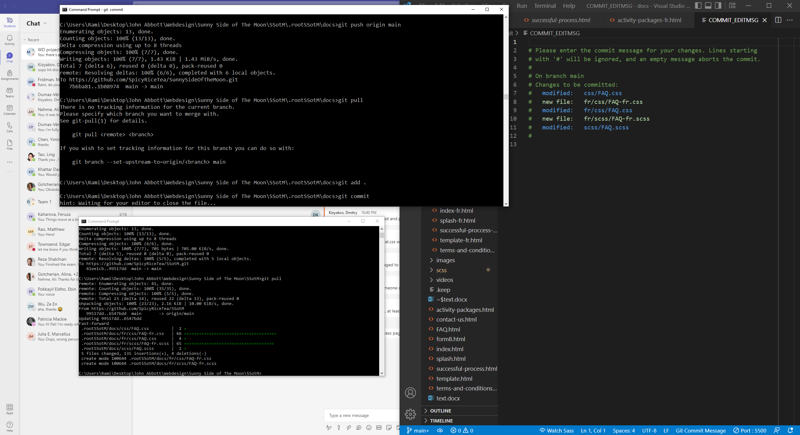
GITHUB
GIT: webhosting + organization

Slide 10

Sunny Side of the Moon Website

